Slide 1

AGILE Presentation by Gordon Price

Slide 2
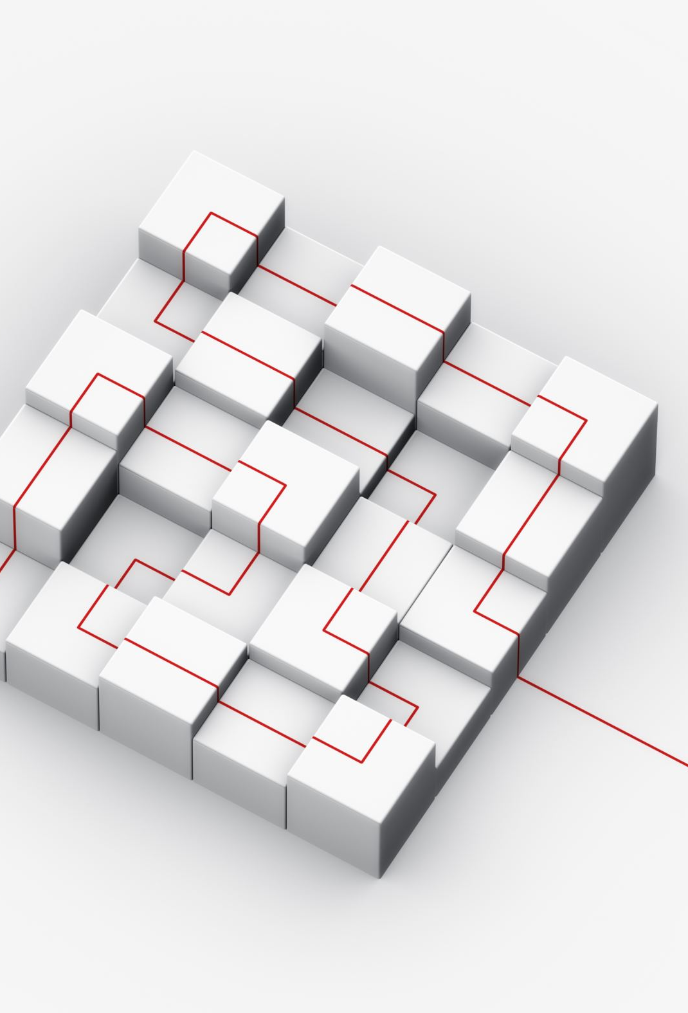
Product Owner Speaks for stakeholder needs. Shapes product features. Decides task order. Ensures the product meets stakeholder needs. Scrum Master Ensures smooth teamwork. Addresses issues. Ensures adherence to agile principles. Creates an effective team environment. Development Team Creates the product piece by piece execute plans across development. Jointly responsible for the end product. Turns ideas into a tangible product.
Meet the Agile Team

Slide 3
SDLC Phases in an Agile Approach Planning Stage We clearly define, prioritize, and estimate user stories. Because this sets the path for development, adapting easily to changes. Execution Sprint The teams work together on user stories in focused sprints. Having clear and concise sprint goals keep the team on the right track. Progress is steady, and adjustments can be made easily. Review Interaction Stakeholders actively give feedback during reviews. Ensures the product aligns with expectations. Continuous feedback keeps the product on the right path. Retrospective Reflection The team reflects on the sprint, identifying strengths and areas for enhancement. Iterative reflections create a culture of constant improvement. Learning from insights leads to better performance.

Slide 4
SDLC Phases in a Waterfall Approach Requirements Gathering Gather and lock in detailed requirements. Changes are tough once the plan is in place. Laying a strong foundation for the entire project. Design Phase Detailed structuring of the whole project. Each phase completes before moving to the next. Creating a blueprint for the entire project. Implementation Stage Actual coding and development activities kick off. Making alterations becomes challenging and costly. Turning plans into a tangible reality. Testing Process Rigorous testing of the fully developed system. Identifying issues and fixing bugs. Ensuring a sturdy, error-free end product. Deployment Moment Launching the product after thorough testing. No changes once the product is live. Officially completing the project journey.

Slide 5
Contrasting Waterfall and Agile Approaches
Different Project Management Approaches:
Waterfall: Characterized by sequential phases, this approach follows a rigid structure where each phase must be completed before moving to the next. Limited stakeholder involvement occurs after the initial planning phase.
Agile: Embraces an iterative and collaborative model. Development occurs in short cycles (sprints), allowing for flexibility, continuous stakeholder feedback, and adaptability to changing requirements.
Handling Problems Differently:
Waterfall: In the face of a development issue, the waterfall model might require revisiting the entire project plan, causing delays. Changes are challenging to implement once the project is underway.
Agile: Agile methodologies excel in addressing issues promptly. With shorter development cycles, adjustments can be made swiftly, ensuring a more responsive and adaptive development process.

Slide 6

Factors that can Influence THE Approach Selection

Slide 7
Making Informed Decisions
Considerations for Waterfall vs. Agile:
Project Complexity: Agile is suitable for projects with evolving and dynamic requirements, whereas waterfall may be preferred for well-defined projects with minimal complexity.
Flexibility Requirements: Agile offers high flexibility, accommodating changes even late in the development process. Waterfall, being sequential, is less flexible in adapting to modifications.
Stakeholder Involvement: Agile encourages continuous stakeholder engagement, while waterfall involves stakeholders primarily in the initial and final phases.
Utilizing Course Experience for Decision-Making:
Drawing insights from our course experience, we recognize that agile methodologies align with dynamic project environments. The emphasis on iterative development and stakeholder collaboration enhances adaptability.

Slide 8
Thank you

